Slide 1
Learn about the Major Food Groups
Cubs Chef Badge

Slide 2
Look at the Eatwell Guide on the next slide ... Can you name the different food groups?
Use the “raise hand” icon to let us know you would like to speak!

Slide 3
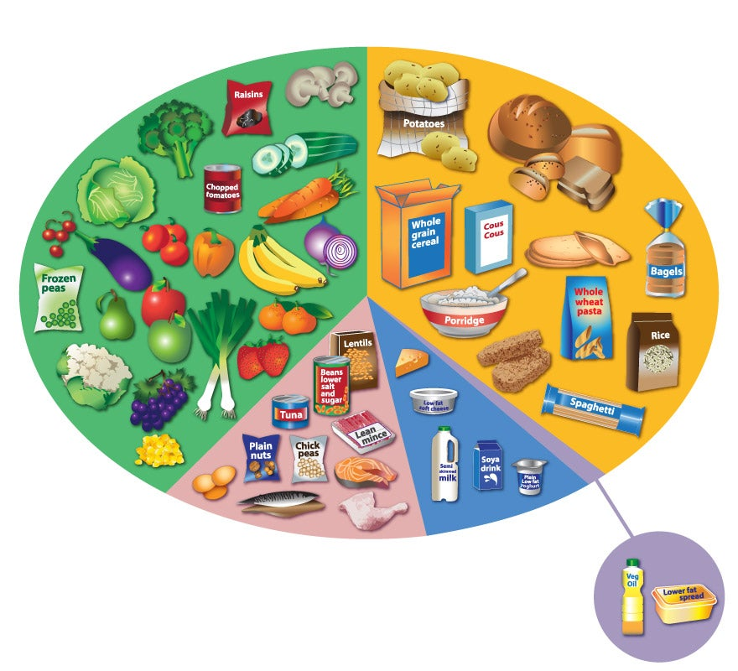

Slide 4
Fruit & Vegetables
Carbohydrates
Low Fats
Proteins
Dairy
Foods high in fats, sugars and salt

Slide 5
Eat at least 5 portions of a variety of fruit and vegetables a day. They are high in vitamins and minerals and good for your eyes, heart, brain and immune system!
Starchy Carbohydrates are a good source of energy and fibre.
Dietary fats are essential to give your body energy and to support cell growth. They help protect your organs and help keep your body warm.
Dairy rich foods are good sources of protein and some vitamins.
They are also an important source of calcium, which helps keep our bones and teeth strong.
Foods high in fat, sugar and salt should be eaten less often and in small amounts.
Your body uses protein to build and repair tissues. Protein is an important building block of bones, muscles, cartilage, skin, and blood.

Slide 6
When the name of a food is called out hold up the correct coloured card
Fruit
& Vegetables
Carbohydrates
Protein
Fat, Sugar & Salt
Dairy
Low Fats

Slide 7
Are you ready to make Rama’s Best Ever Mug Cake?
Watch the video so that you are prepared to cook!
https://www.youtube.com/watch?v=DoSq9T6OejA

Slide 8
How to stay safe in the kitchen
https://www.youtube.com/watch?v=3DdQ0lGsU5g&feature=youtu.be&list=PLe-9aCSqLpF9NQxXM7_nAM8nJb3kKODy9&fbclid=IwAR3Xe5sfhWq1iDiM_lRc4yBuZVOAIrDqk8epjzmO75yxCDUbVzDh0EUD9W8

Slide 9
Some links to send home at the end of the evening to supplement what the Cubs have learned
https://lifeliveit.redcross.org.uk/Microsites/LifeLiveItPrimary/Popups/section_2_2_1.aspx
https://www.foodafactoflife.org.uk/7-11-years/healthy-eating/interactive-resources/#EC
http://www.sheppardsoftware.com/nutritionforkids/games/foodgroupsgame.html?fbclid=IwAR3Y49YwEgLqUIt5B9ZcxsJRsvXB1bRzNTxgazMdCfz7g36M2qTApdYxGdc

