Slide 1
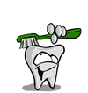
Looking After our teeth

Slide 2
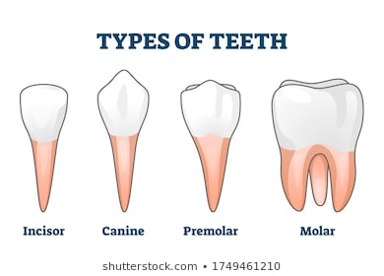
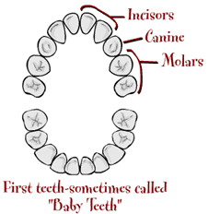
Types of teeth
4 different types of teeth-
Baby teeth are also called Primary teeth

Slide 3
What do different teeth do?
incisors
canines
Cut –
You loose these first
tear
pre molars
molars
chew
rip

Slide 4
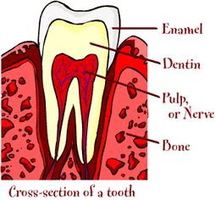
parts of a tooth?

Slide 5
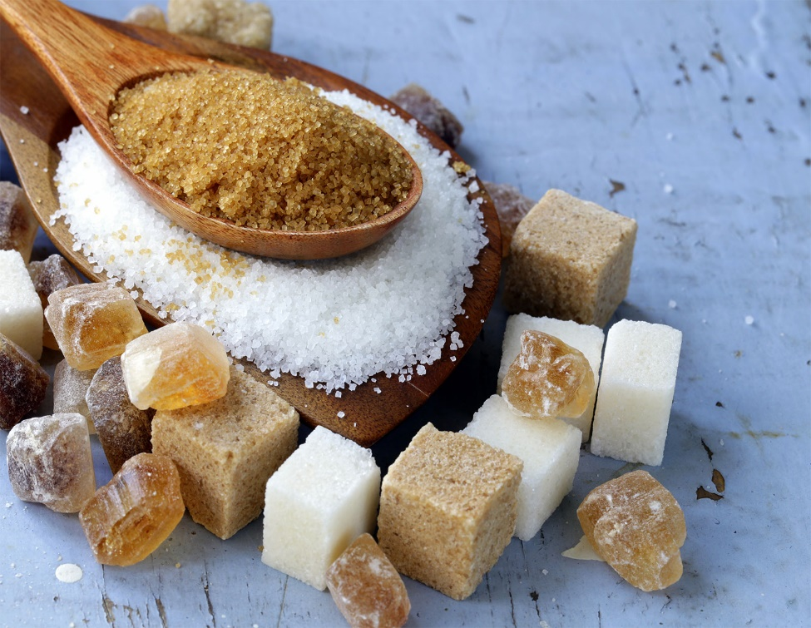
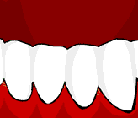
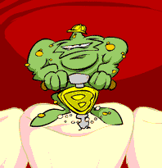
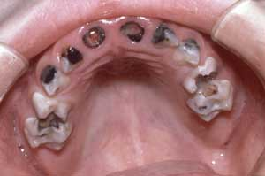
How are cavities caused?
Bacteria in your mouth uses sugar to produce a build up of plaque acid
Plaque acid attacks the tooth
The tooth eventually rots away

Slide 6
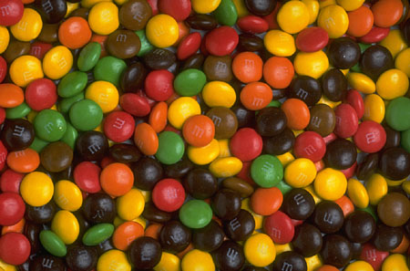
How do I look after my teeth?
Brush your teeth twice a day
Try not to eat too many sweets
Visit the dentist twice a year

Slide 7
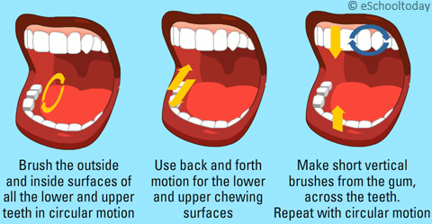
How to brush your teeth
Twice a day for 2 minutes
Manual or electric toothbrush
Use fluoride toothpaste
Don’t rinse after spitting

Slide 8
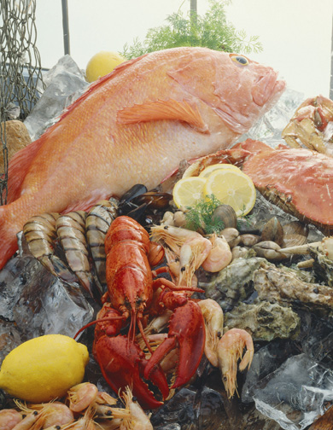
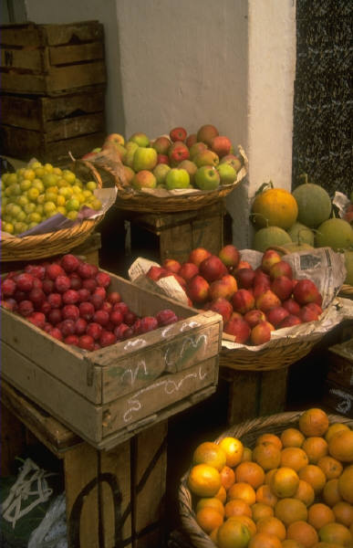
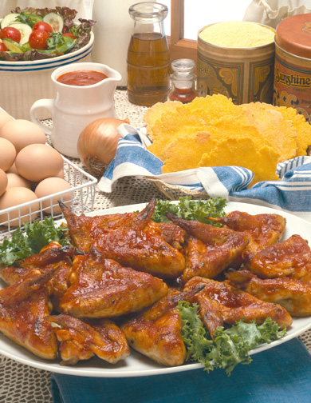
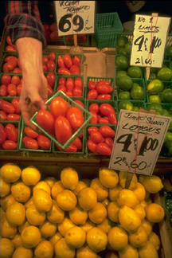
Foods that are good for teeth

Slide 9
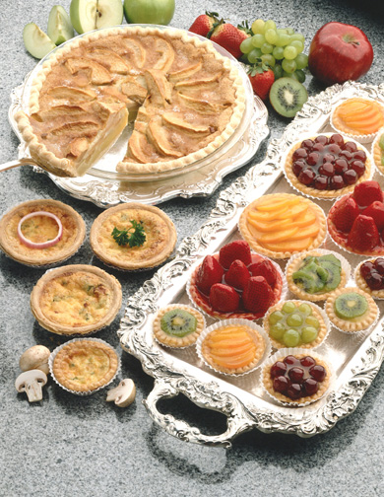
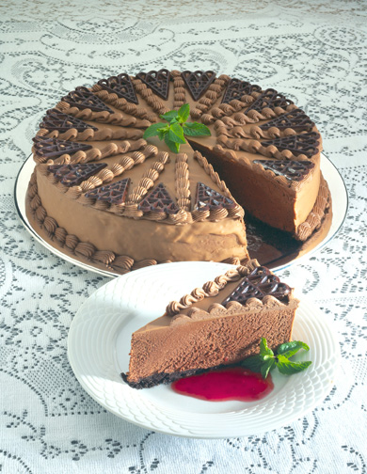

Foods that cause tooth decay

Slide 10
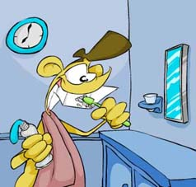
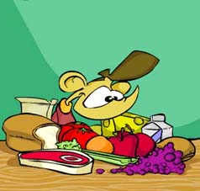

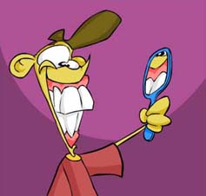
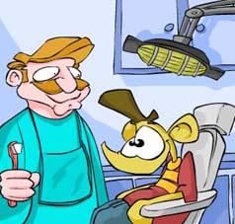
So remember…
Brush regularly
Eat sensibly
Floss and/or
mouthwash
Look after your gums
Visit the dentist

