Slide 1
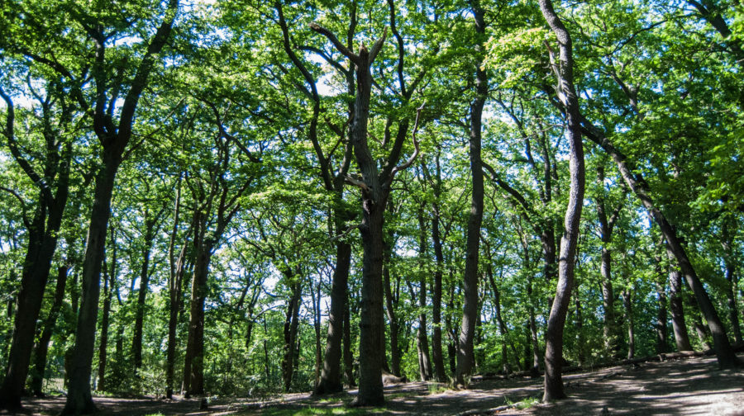
TREES

Slide 2
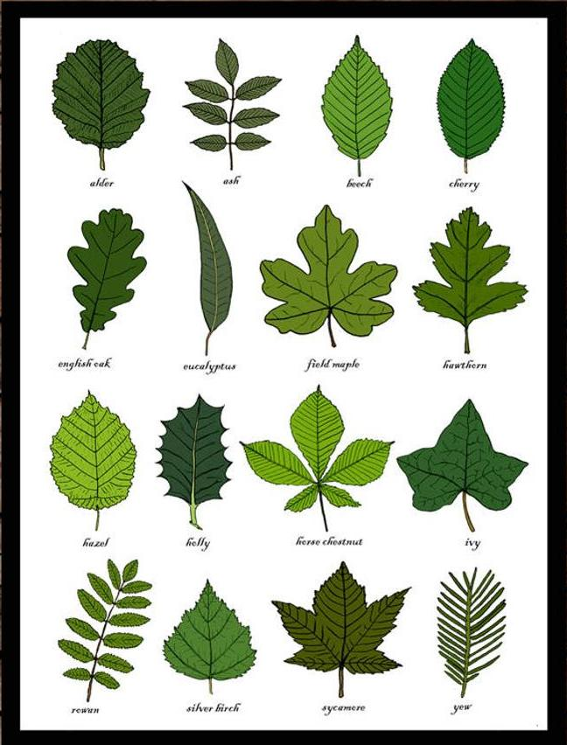
LEAVES ARE THE EASIEST WAY TO IDENTIFY
A TREE

Slide 3
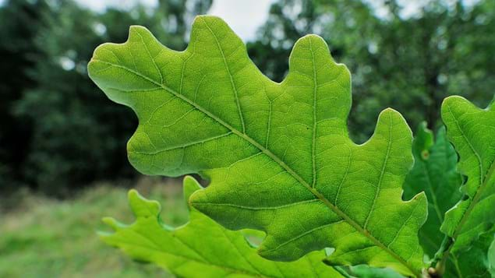

Slide 4
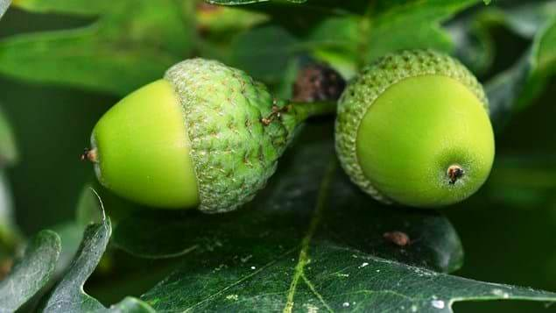

Slide 5
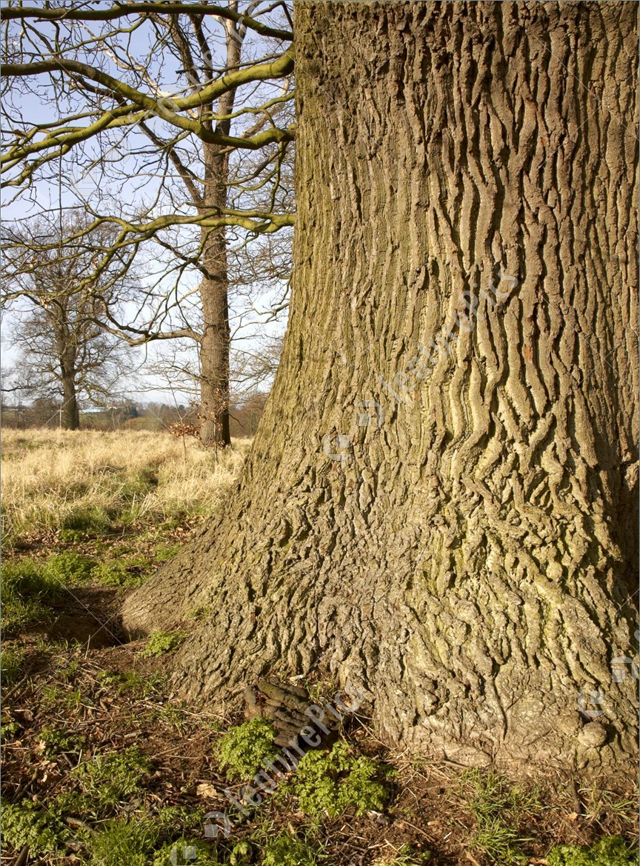

Slide 6
OAK

Slide 7
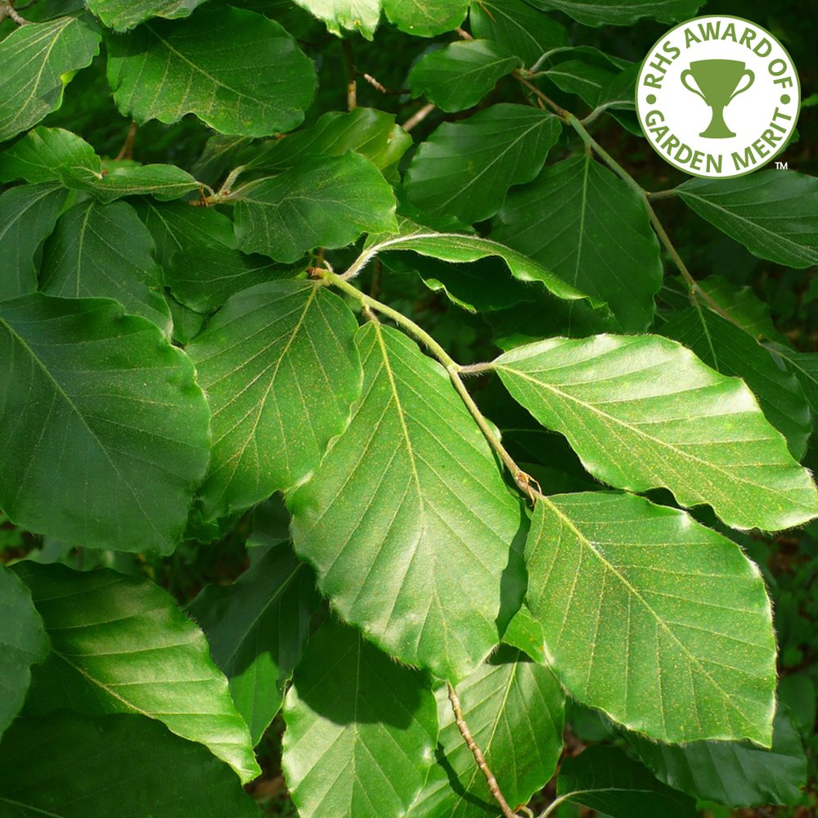

Slide 8
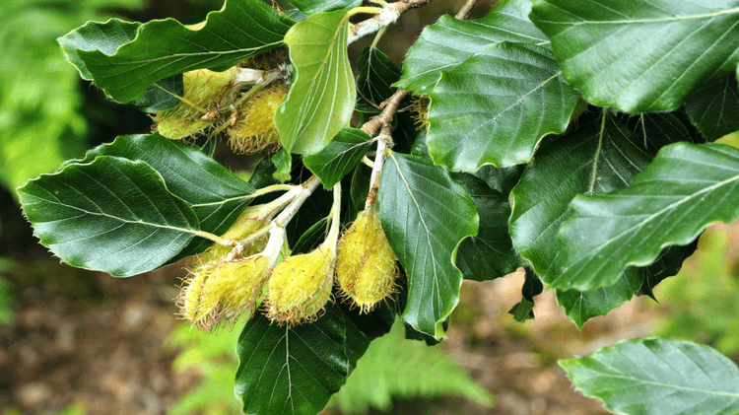
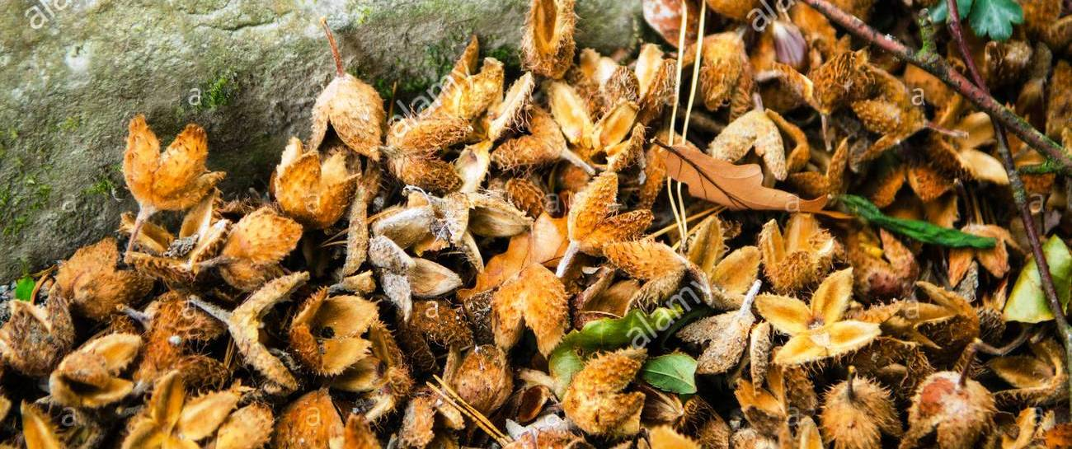

Slide 9
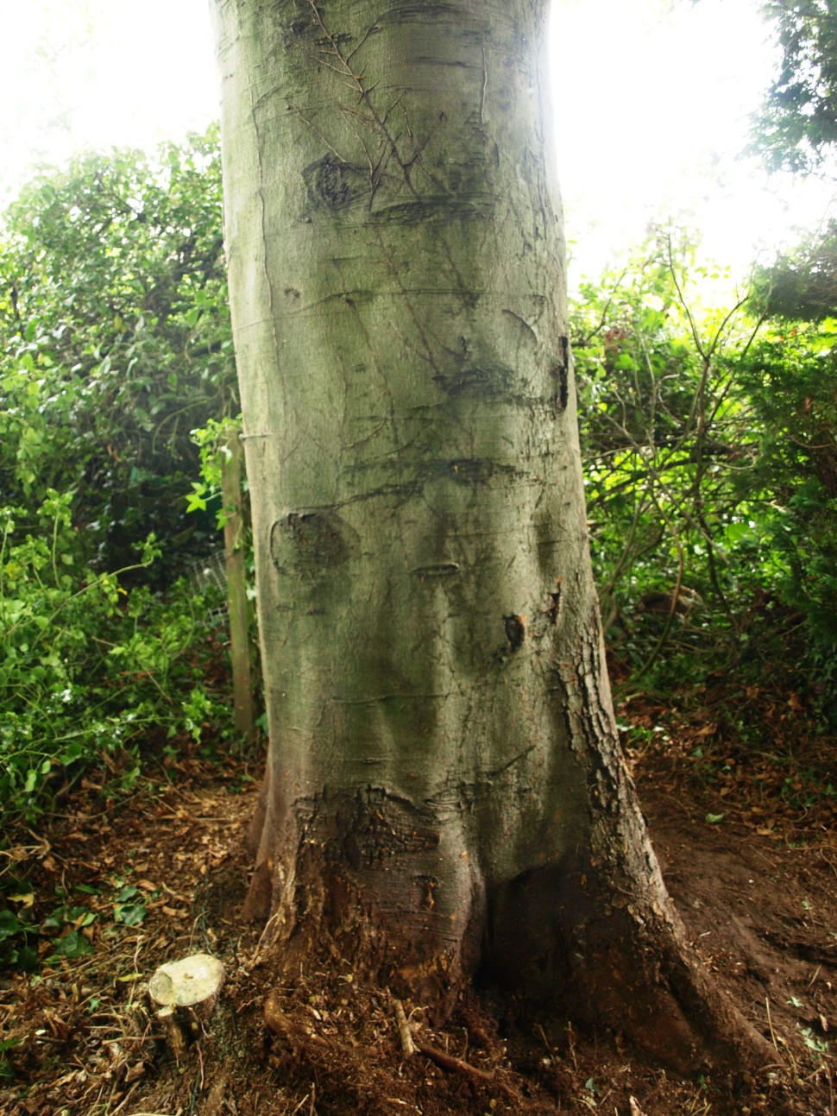

Slide 10
BEECH

Slide 11
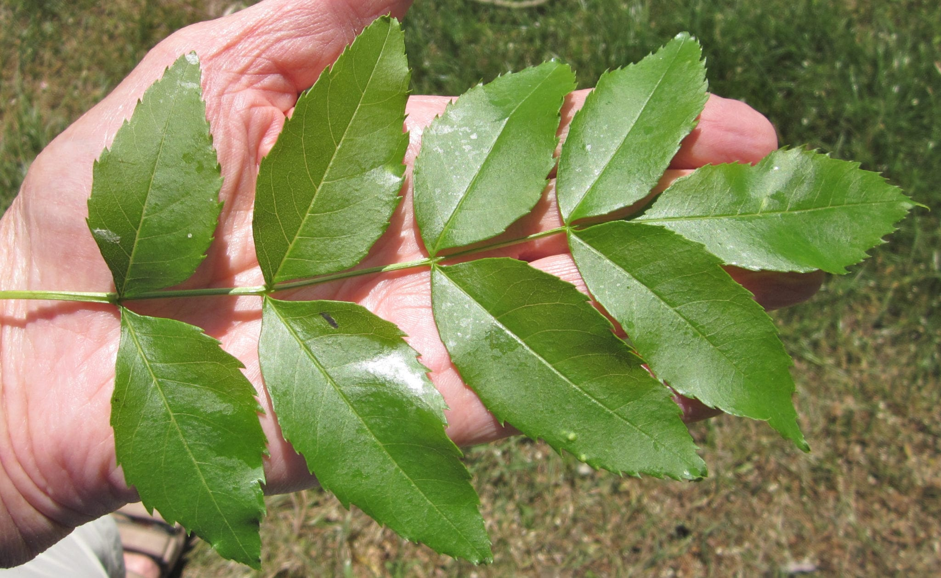

Slide 12
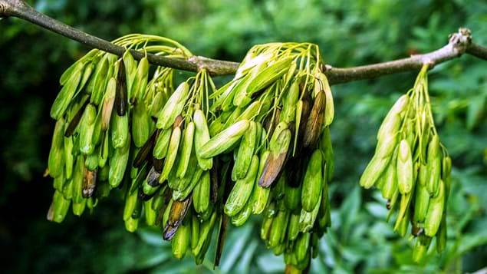

Slide 13
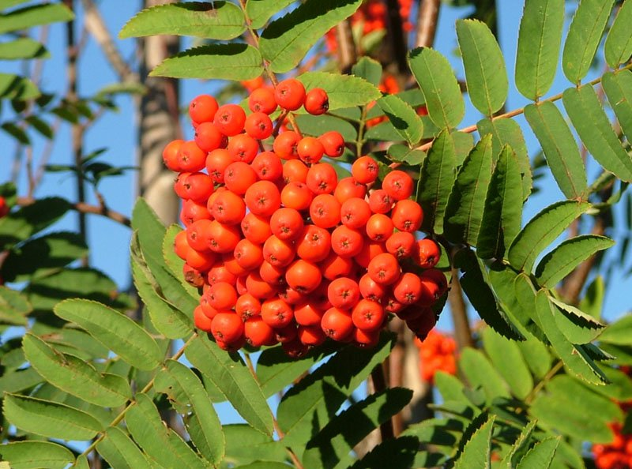

Slide 14
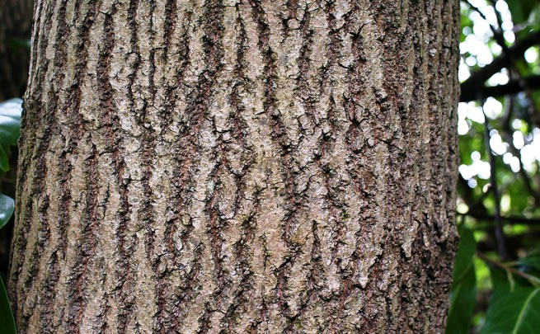

Slide 15
ASH
ROWAN – MOUNTAIN ASH

Slide 16
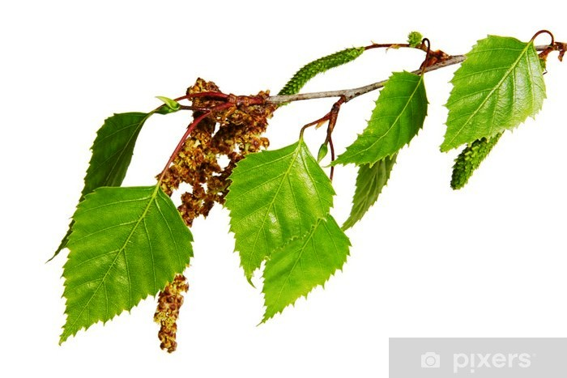

Slide 17
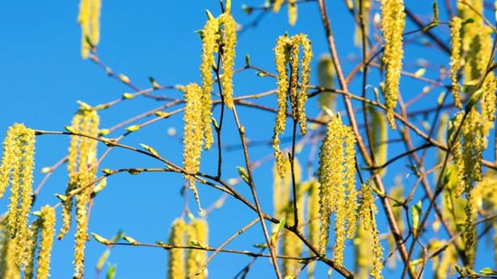

Slide 18
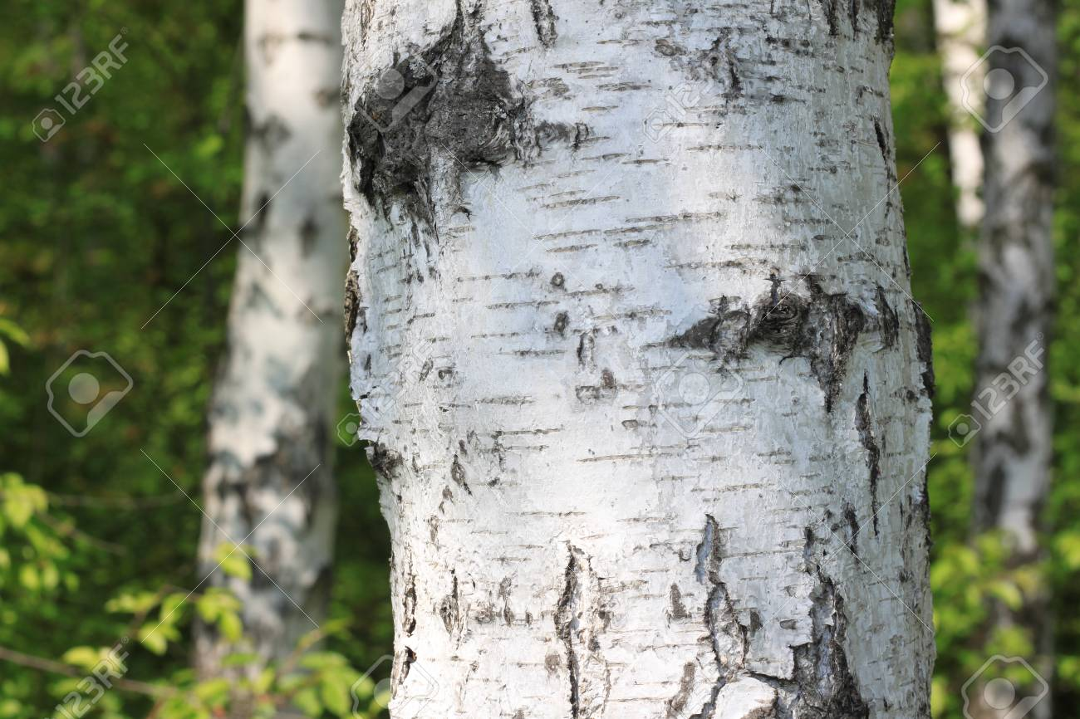

Slide 19
SILVER BIRCH

Slide 20
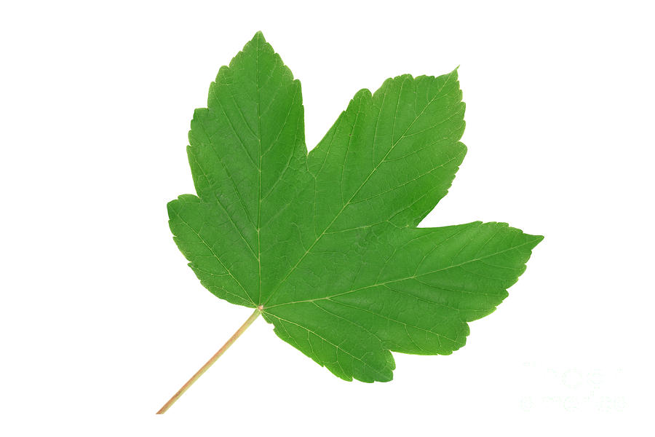

Slide 21
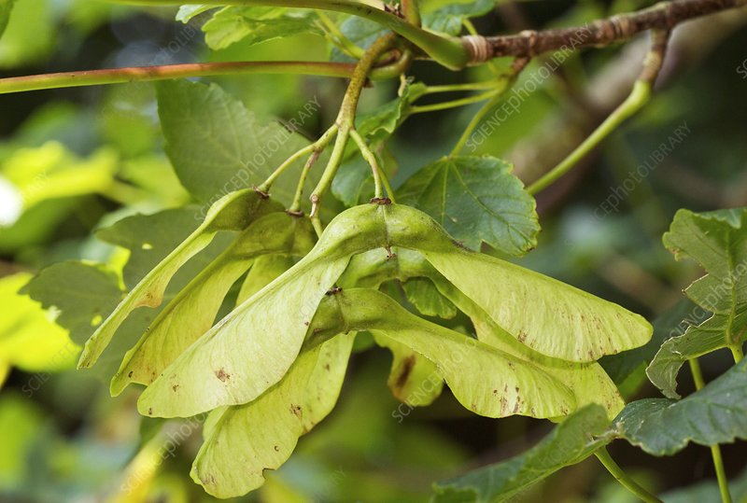

Slide 22
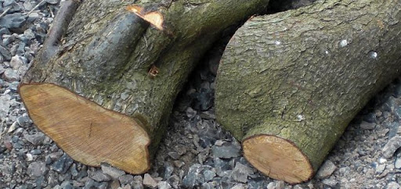

Slide 23
SYCAMORE

Slide 24
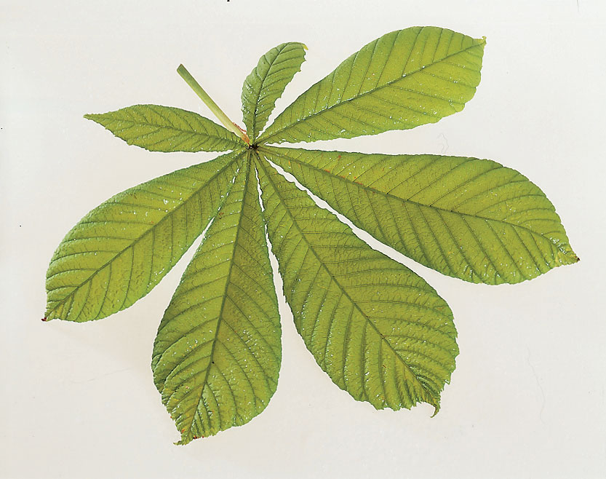

Slide 25
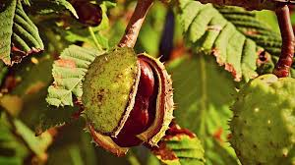
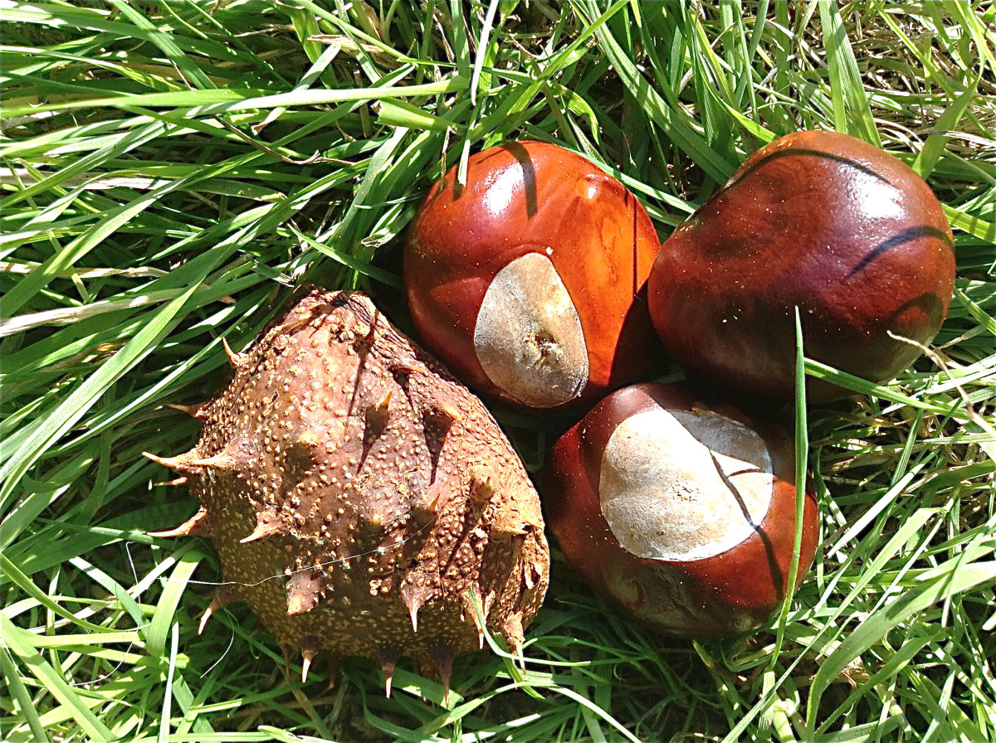

Slide 26
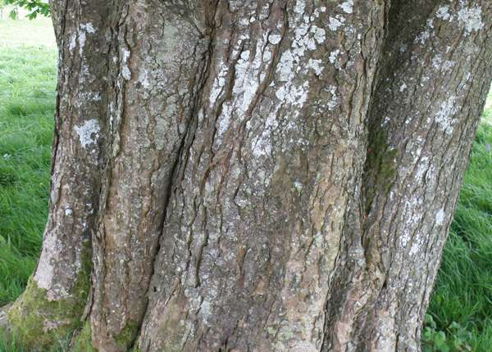

Slide 27
HORSE CHESTNUT

Slide 28
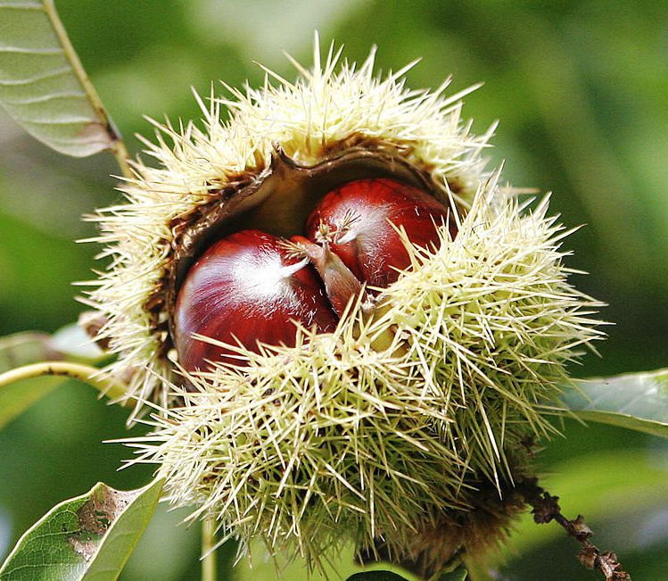
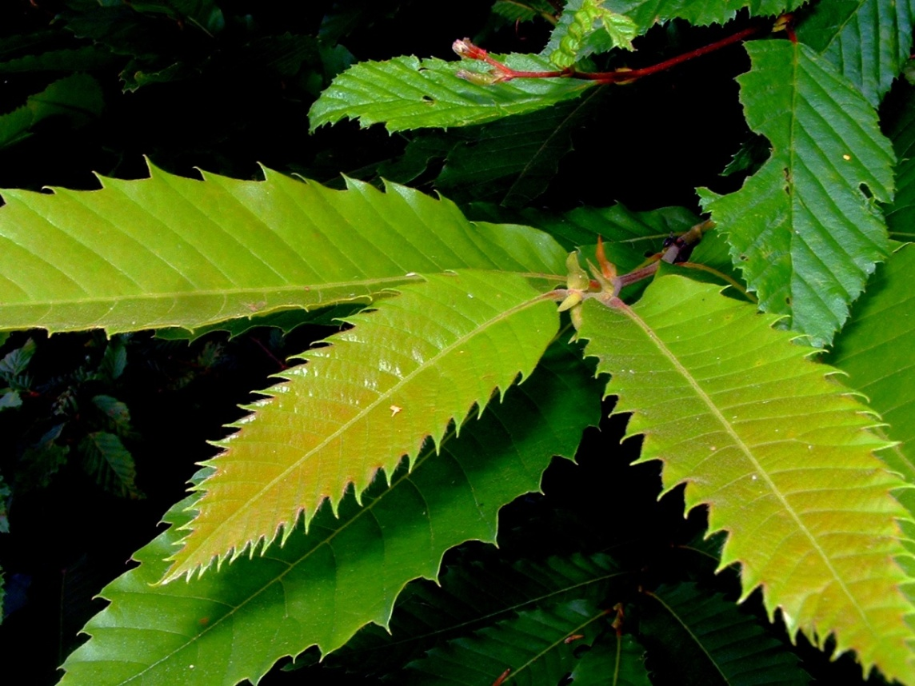
SWEET CHESTNUT - EDIBLE
HORSE CHESTNUT - POISONOUS

Slide 29
Beechwood fires are bright and clear If the logs are kept a year, Chestnut's only good they say, If for logs 'tis laid away. Make a fire of Elder tree, Death within your house will be; But ash new or ash old, Is fit for a queen with crown of gold
Birch and fir logs burn too fast Blaze up bright and do not last, it is by the Irish said Hawthorn bakes the sweetest bread. Elm wood burns like churchyard mould, E'en the very flames are cold But ash green or ash brown Is fit for a queen with a golden crown
Poplar gives a bitter smoke, Fills your eyes and makes you choke, Apple wood will scent your room Pear wood smells like flowers in bloom Oaken logs, if dry and old keep away the winter's cold But ash wet or ash dry a king shall warm his slippers by.

Slide 30
These hardwoods burn well and slowly,
Ash, beech, hawthorn, oak and holly.
Softwoods flare up quick and fine,
Birch, fir, hazel, larch and pine.
Elm and willow you'll regret,
Chestnut green and sycamore wet

Slide 31
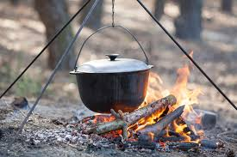
THE RIGHT WOOD WILL COOK YOUR DINNER

Slide 32
THE WOODLAND TRUST HAVE A GREAT APP TO HELP YOU IDENTIFY TREES – AND ITS FREE!

