Slide 1
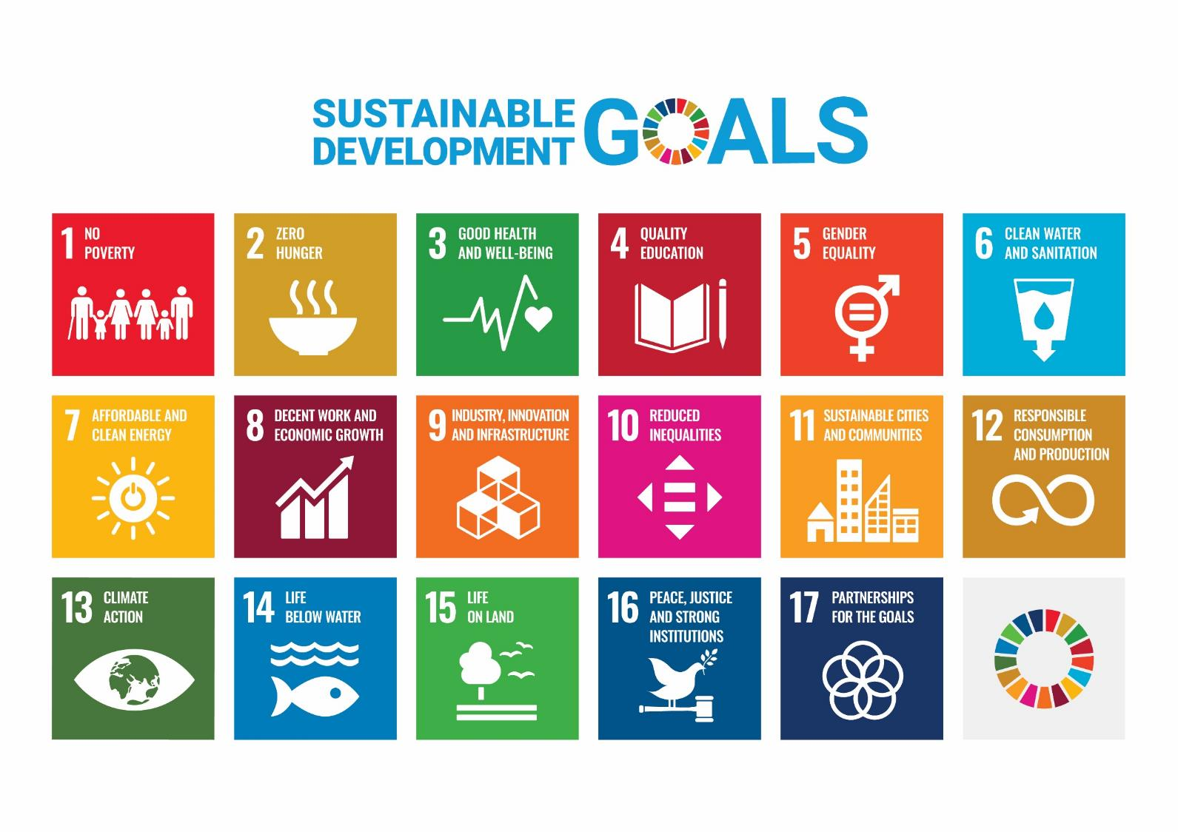
Notes:
Notes to leaders
This session explores UN Sustainable Development Goal #15 – Life on Land – specifically looking at deforestation.
It’s based on the activity pack developed by Scouts Scotland and Scotdec: https://www.scouts.scot/media/1606/goal-15-life-on-land.pdf (for more SDG activities, look here:
https://www.scouts.scot/members/programme/international-support/sustainable-development-goals-resources/)
Depending on the level of discussion you have with your young people it will probably take approx. 40 minutes.

Slide 2

Notes:
What are the UN Sustainable Development Goals (SDGs)?
Play intro video: https://worldslargestlesson.globalgoals.org/resource/malala-introducing-the-the-worlds-largest-lesson/

Slide 3
Notes:
What are the UN Sustainable Development Goals (SDGs)?
The 17 goals were adopted by world leaders 5 years ago. Their aim is to get all countries to work together to end all forms of poverty, fight in equalities and tackle climate change whilst ensuring that no one is left behind.
Tonight we’re going to focus on goal 15

Slide 4

2 billion hectares of land are degraded
Over 31,000 species are threatened with extinction
Protect, restore and promote sustainable use of terrestrial ecosystems, sustainably manage forests, combat desertification, and halt and reverse land degradation and halt biodiversity loss.
Notes:
Goal 15: Life on land
2 billion hectares of land are degraded - that’s an area only slightly smaller than Canada, the USA and Mexico put together, affecting 3.2 billion people, driving species to extinction and intensifying climate change.
The aim of this goal is to “Protect, restore and promote sustainable use of terrestrial ecosystems, sustainably manage forests, combat desertification, and halt and reverse land degradation and halt biodiversity loss.”
Specifically we’re going to think about forests – and what the consequences of global deforestation might mean for us.

Slide 5
How fast are rain forests being destroyed?
25-36 football fields per minute
10-18 football fields per minute
5-9 football fields per minute
1-3 football field per minute
Notes:
How fast are rain forests being destroyed?
Get people to shout out their guesses, then reveal the answer – 25 football fields a minute
So what?
The next activity is going to get you thinking about what this means to the people that live in those forests, and to the rest of the world.
The next activity is best run in small groups (ideally less than 6, if you’ve got enough adult helpers) – split your meeting into breakout groups, each will need a leader with a copy of the next slide.

Slide 6
Trees absorb carbon dioxide and release oxygen and purify the air we breathe. Without the trees of the rainforest our air will be more polluted.
People living in and around the rainforests depend on fresh water to grow their crops and stay healthy. As the forest is cut down the water supply falls as the rainfall decreases.
Trees are cut down to plant soybeans and palm oil trees.
Chemicals sprayed onto these trees pollute the rivers, kill many of the fish, destroy people’s crops and can cause health problems.
Forests protect the soil from the rain. Without them the soil is washed away into the creeks and rivers and can cause flooding.
Rainforests pump heat from the hot regions of the world to the cooler regions, and without them the climate will change.
More than half of the world’s animal species live in the rainforest. When the forest is destroyed species die out and important biodiversity is lost.
Tree canopies provide shade, cooling the environment around them.
The rainforests have evolved over millions of years and once they have
been cut down it takes many years for them to regrow.
Forests absorb and store carbon. When the forest is cleared the carbon is released as carbon dioxide which contributes to climate change.
Rainforest plants are used to make medicine to help find cures for diseases. If the forests are destroyed we lose the chance to discover important new medicines.
When the forest is cut down the people who live there lose their homes, livelihoods and way of life.
Notes:
So what?
In your break-out group, sort the virtual cards into 2 “piles” (the leader facilitating the session should share this slide in “edit” view, and drag the boxes around the screen to make the piles):
How forest clearance affects the people, plants and animals that live in the rainforest (4 cards)
How forest clearance affects us globally (7 cards)
Then rank these 7 “How forest clearance affects us globally” cards according to which issues they think are most important and which issues are least important. They can rank the cards with the 2 most important at the top and the 2 least important at the bottom.
(You might want to talk about the next slide in small break out groups)
Once each break-out group has sorted the cards and out the 7 global effects into priority order, come back together get each group to share their most important and least important issues and discuss their choices.

Slide 7
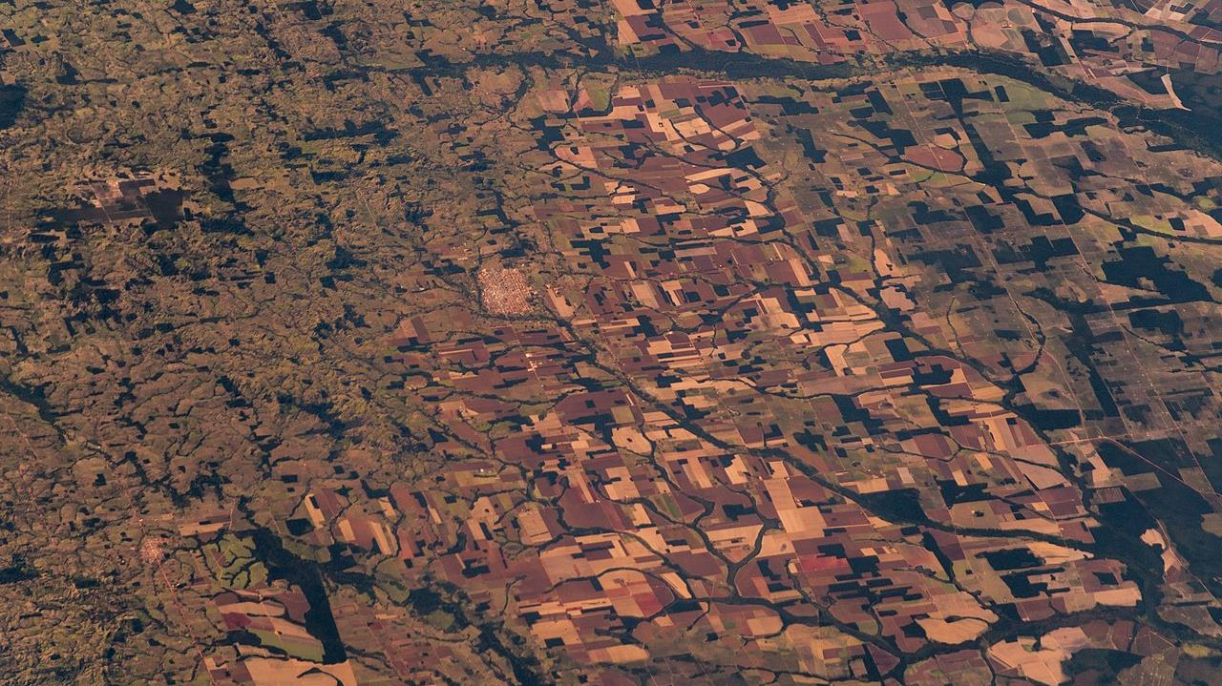
But why?
Astro_Alex
Notes:
But why? (You may find it easier to do this in small break out groups before coming back together)
Get Scouts to brainstorm why they think trees are being cut down:
To make paper/for the wood
To grow crops
To farm animals
Mining

Slide 8
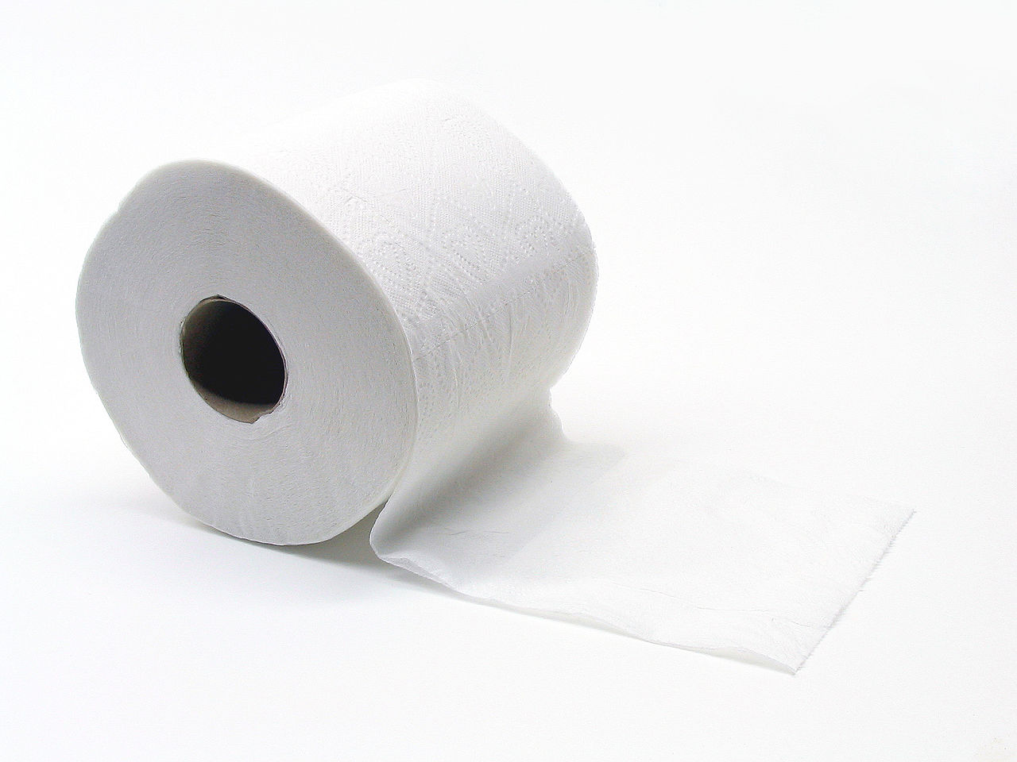
True or false?
27,000 trees are chopped down per day just to make toilet paper.
TRUE
Original image by: Brandon Blinkenberg
Notes:
True or false
You’re going to see a number of statements linked to deforestation and it’s causes. You need to decide if they’re true or false. (We used the Zoom voting buttons to get people to show whether they thought a statement was true or false).
27,000 trees are chopped down per day just to make toilet paper – TRUE
These include tropical hardwood trees from the rainforests
Western consumers demand 4-ply thick toilet paper that’s made from virgin pulp. As more people are becoming wealthier across the earth the “luxury” toilet paper is industry is growing rapidly.
Swapping to 2-ply recycled toilet paper will help stop deforestation. Bamboo toilet paper is also a great choice as it’s wood that grows quickly and is sustainable. Otherwise look for the FSC logo and choose toilet paper that comes paper made from sustainable sources of timber.

Slide 9
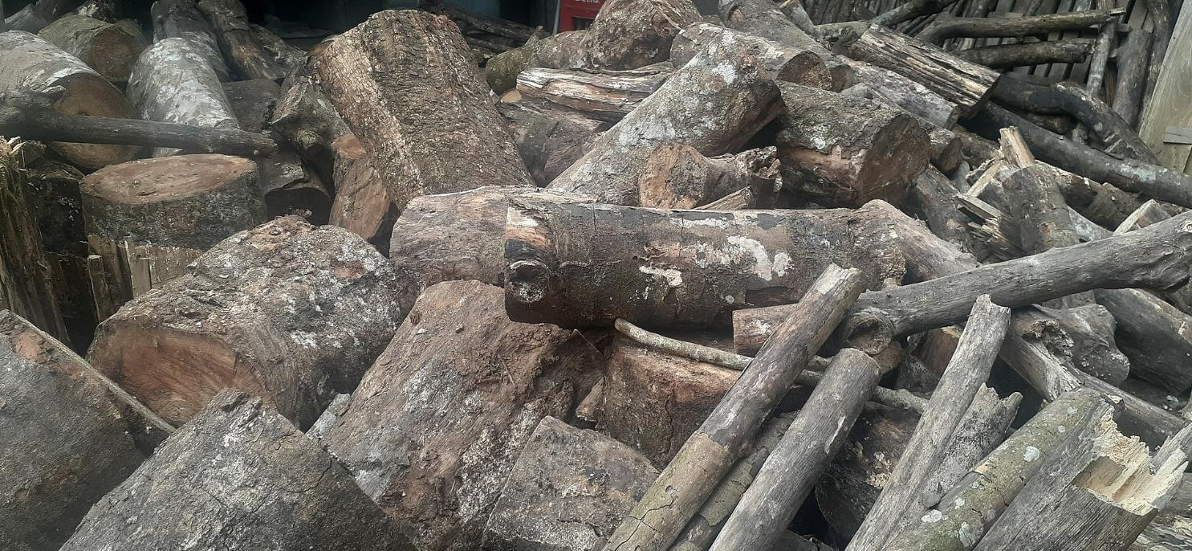
True or false?
Most trees are cut down for their timber.
FALSE
Original image by: Cyndisitepu
Notes:
Most trees are cut down for their timber - FALSE
the biggest driver of deforestation is agriculture - this means the food we eat is directly causing deforestation.
In tropical and subtropical countries, agriculture has accounted for 73% of deforestation

Slide 10
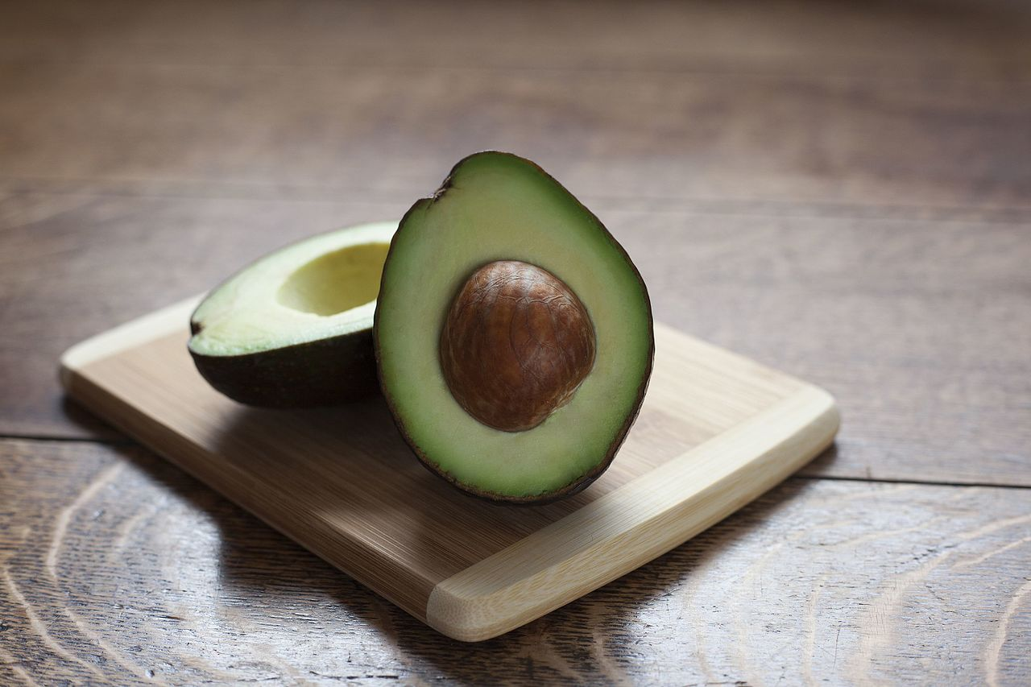
True or false?
Per person consumption of avocados in the US has increased 440%
TRUE
Original image by: Kjokkenutstyr
Notes:
Per person consumption of avocados in the US has increased 440% - TRUE
But the majority of deforestation is linked to meat, soya beans and palm oil.

Slide 11
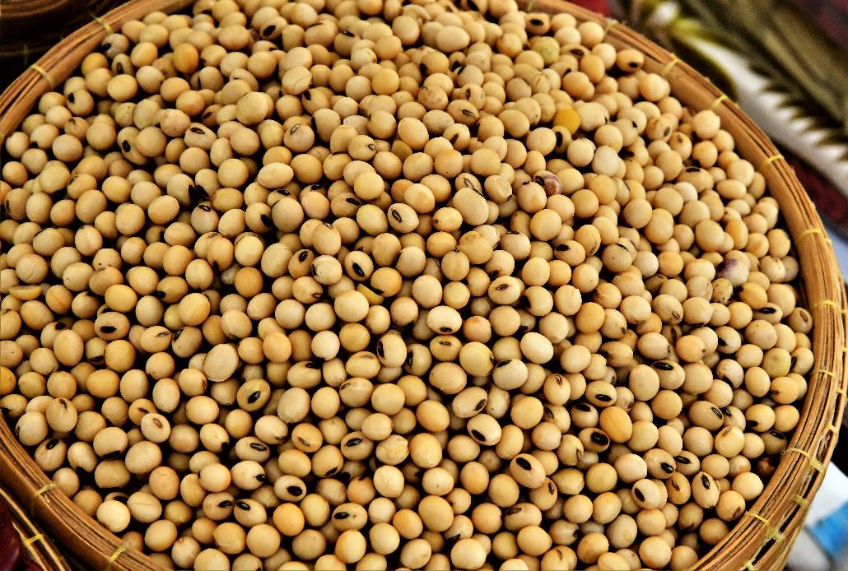
True or false?
Approximately 30 million hectares of land in Brazil are used to grow soy.
TRUE
Original image by: Tris T7
Notes:
Approximately 30 million hectares of land in Brazil are used to grow soy – TRUE
However most of this soy isn’t used for vegetarian food and milk alternatives

Slide 12
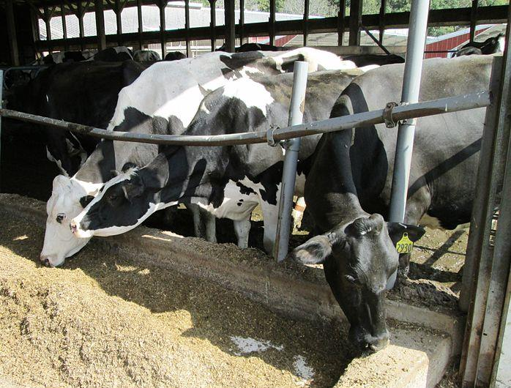
True or false?
Over 75% of soy is used to feed animals.
TRUE
Original image by: Beyond My Ken
Notes:
Over 75% of soy is used to feed animals. - TRUE

Slide 13
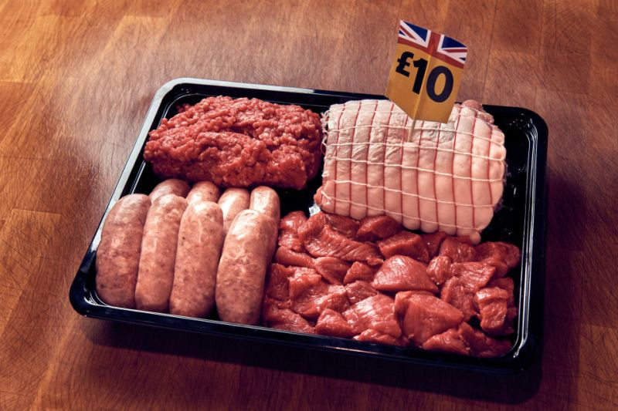
True or false?
Eating British meat doesn’t contribute to deforestation
to grow soy.
FALSE
Morrisons
Notes:
Eating British meat doesn’t contribute to deforestation to grow soy. – FALSE
We import soy to feed to British livestock

Slide 14
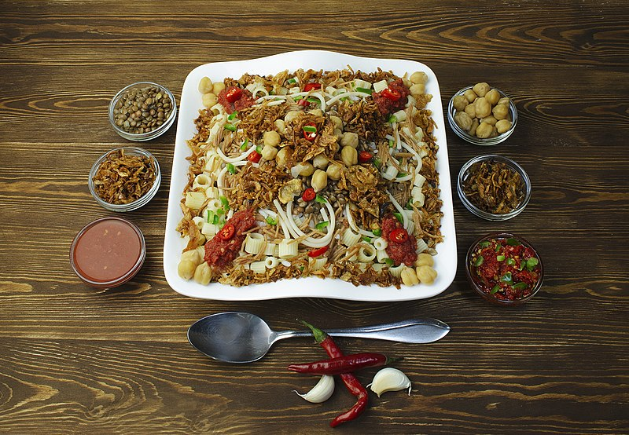
True or false?
If everyone went vegetarian, the problem would be solved.
FALSE
Original image by: Dina Said
Notes:
If everyone went vegetarian, the problem would be solved - FALSE
Palm oil is found in nearly 50% of the packaged products we find in supermarkets: everything from pizza, doughnuts and chocolate, to deodorant, shampoo, toothpaste and lipstick. Irresponsible palm oil production has been – and continues to be – a major driver of deforestation of some of the world’s most biodiverse forests, particularly across Indonesia and Malaysia who combined make up approximately 85% of the world’s palm oil production. Unabated expansion over recent decades has been responsible for destroying the habitat of already endangered species like the Orangutan, pygmy elephant and Sumatran rhino.

Slide 15
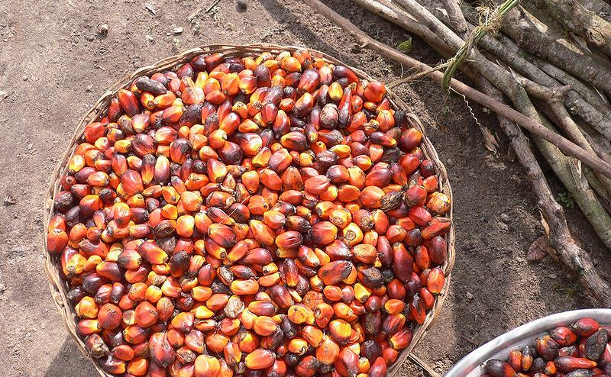
True or false?
Palm oil is more land efficient than any other vegetable oil crop.
TRUE
Original image by: oneVillage Initiative
Notes:
Palm oil is more land efficient than any other vegetable oil crop - TRUE
Globally, it supplies 35% of of the world’s vegetable oil demand on just 10% of the global land used to grow vegetable oil crops. To get the same amount of vegetable oil from equivalent crops like soybean or coconut could require anything between 4 and 10 times more land

Slide 16
Scavenger hunt – how many things can you find containing soy or palm oil?
Soy is also know as
soya
soy lecithin
tofu
miso
Palm oil may also be called:
palmate
palmitate
palmitic acid
stearate
stearic acid
Notes:
Run the scavenger hunt. See if they’re surprised by some of the things they’ve found that include soy or palm.
Discuss how they and their families can adjust their consumer habits to help reduce our impact on the planet, for example by buying products that use sustainable palm oil.

