Slide 2
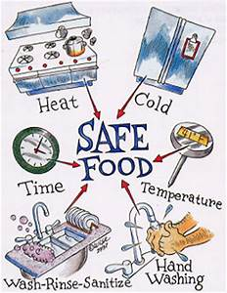
SAFE COOKING
Before you start – WASH YOUR HANDS
Tie long hair back
Wear an apron – to keep your clothes clean
Keep surfaces clean and tidy
Don’t lick your fingers when preparing your food
Keep raw and fresh food separate
Listen to the instructions
Take care with hot pans and food
Make sure food is cooked through
Ask an adult for help with the oven
Knives are sharp – Take care and ask for help

Slide 3
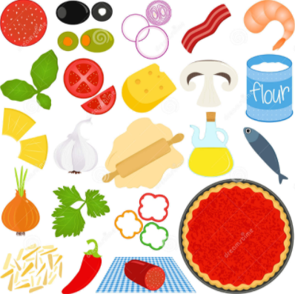
INGREDIENTS
Pizza base
125g natural yogurt
125g Self Raising flour
1tsp baking powder
Pinch salt
Topping
2-3 tbs Tomato Passata or Puree
1 tsp Dried mixed herbs
2-3 tbs Grated cheese (Mozzarella or cheddar)
Topping of choice*chopped up* example: Ham, pepperoni, peppers, mushrooms, sweet corn, Basil, Olives etc

Slide 4
SAFE COOKING
Equipment
Oven – Pre heated to 180 Fan, 200c, Gas mark 6
Mixing bowl
Weighing Scales
Pizza tray for oven
Oven gloves
Chopping board
Knife
Rolling Pin
Desert spoon
Tea spoon
Serving plate
Fish slice (to move pizza base)

Slide 5
STEP 1
Pizza Base
Oven should already be heated to 220c
Weigh out the flour in a bowl 125g
Weigh out the yoghurt 125g and add to the bowl with the flour
Mix in 1tsp baking powder
Add a pinch of salt
Mix ingredients together in the bowl into a ball.

Slide 6
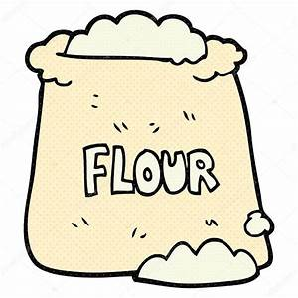
STEP 2
Pizza Base
Divide the dough into 4 balls
Sprinkle flour on the clean surface
Use the rolling pin and roll out each ball on a floured surface. To form the pizza bases
Put the pizza bases on the pizza tray for the oven
Put the pizza bases in the oven to cook for 5 minutes. It will puff up slightly.
When pizza base in oven wash hands and tidy up a bit.
Remove the bases after this time and then turn them over

Slide 7
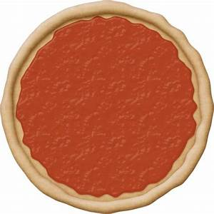
STEP 3
Spread the tomato puree over the base of the pizza (3-4 tbs)
Sprinkle over the mixed herbs (1 tsp)
Sprinkle over a layer of grated cheese

Slide 8
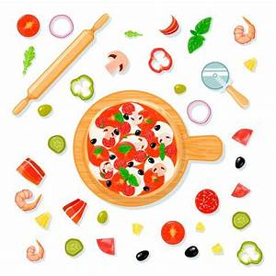
STEP 4
Add the toppings you want to have
If you need to chop the toppings up do so carefully with the knife
Put in the oven again for 5 minutes until cheese melted.
Turn off the oven

Slide 9
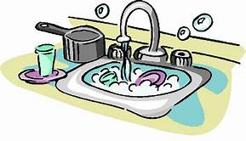
STEP 5
Whilst Pizza is cooking (and allowing to cool down) clear up and tidy away!
Get plates ready

Slide 10
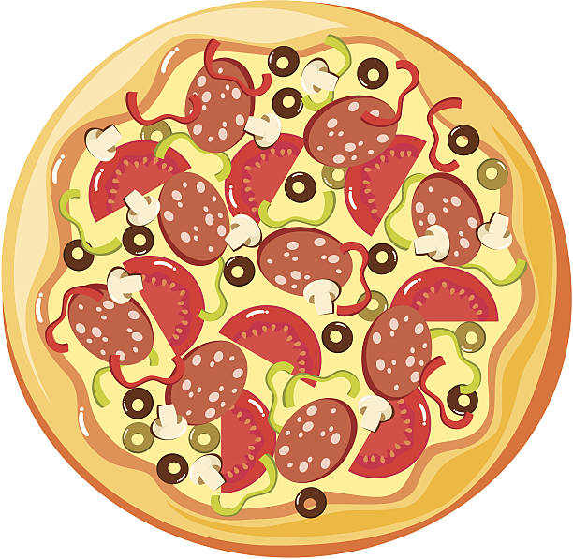
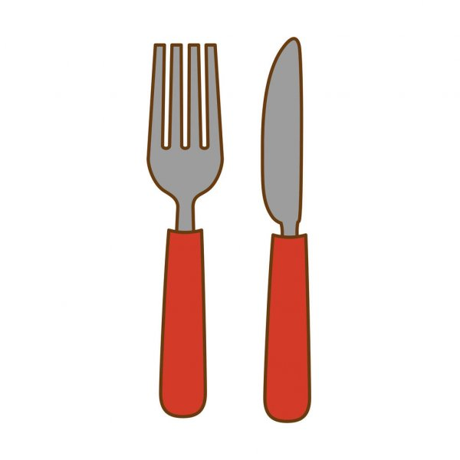
STEP 6
ENJOY!

