Slide 1
India
Today we are going to be looking at and learning about India, as part of our World Challenge Award.
We will be learning about some traditions and festivals of the country and making a greetings card to celebrate one of them.
We will also be learning about Scouting in India, looking at their Cub Promise and playing a game that Cubs enjoy there.

Slide 2
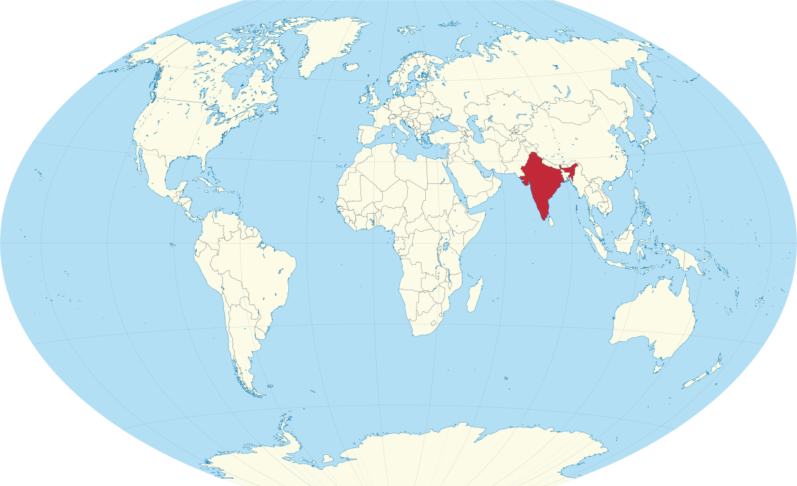
So where is India?
This Photo by Unknown Author is licensed under CC BY-SA

Slide 3
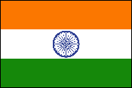
The Flag of India
India's flag was adopted on July 22, 1947, after India became independent from Great Britain.
Each colour represents something different:
Saffron represents courage and sacrifice
White represents peace, unity and truth
Green represents faith and fertility
Blue represents the sky and the ocean
In the centre of the white band is a blue wheel with 24 spokes. This is the Dharma Chakra (or "Wheel of Law"). The Chakra represents the continuing progress of the nation and the importance of justice in life.

Slide 4
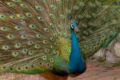
Symbols of India

Slide 5
Some quick facts about India
India has about 15 major languages but Hindi and English are the official languages of the country.
India’s history goes back to 3200BC when Hinduism was first founded. There are many other religions in India nowadays, including Buddhism, Sikhism, Islam and Christianity.
India is the 7th largest country in the world.
The currency of India is the Rupee.
The capital is New Delhi.
The population of India is 1,384,660,352 (Nov. 2020), making it the second most populated country after China. It is more than 3 times the population of the United States, although its area is only about one-third of the US.
India is land of festivals – the most widely known are Diwali and Holi.

Slide 6
Holi
Holi was originally a spring festival of fertility and harvest. Now it also marks some Hindu legends, which provide some of the ingredients for the celebrations.
The Legend of Prahalad and Holika
This is the main Holi legend. Holika was a female demon, and the sister of Hiranyakashyap, the demon king. Hiranyakashyap considered himself ruler of the Universe, and higher than all the gods.
Prahalad was the king's son. His father hated him because Prahalad was a faithful devotee of the god Vishnu.
One day the king asked him "Who is the greatest, God or I?"
"God is," said the son, "you are only a king."
The king was furious and decided to murder his son.
But the king's attempts at murder didn't work too well. Prahalad survived being thrown over a cliff, being trampled by elephants, bitten by snakes, and attacked by soldiers.

Slide 7
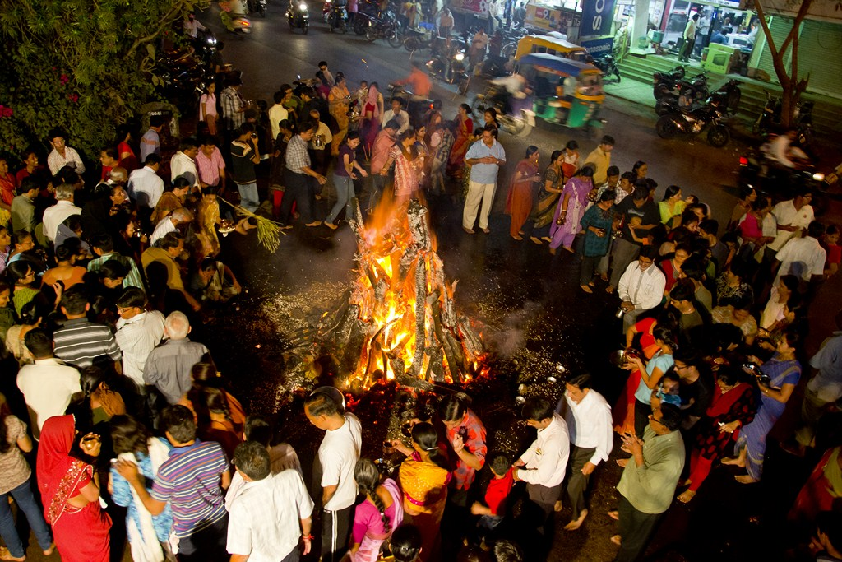
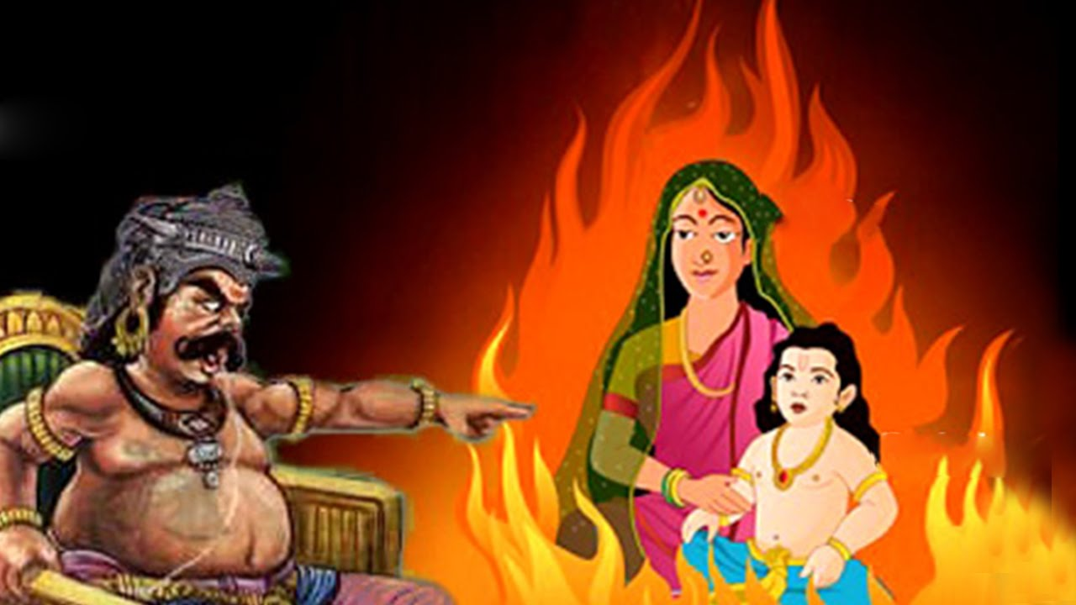
So the king asked his sister, Holika, to kill the boy.
Holika seized Prahalad and sat in the middle of a fire with the boy on her lap.
Holika had been given a magic power by the gods that made her immune to fire, so she thought this was a pretty good plan, and Prahalad would burn to death while she remained cool.
But it's never wise to take gods' gifts for granted! Because Holika was using her gift to do something evil, her power vanished and she was burned to ashes. Prahalad stayed true to his God, Vishnu, and sat praying in the lap of his demon aunt. Vishnu protected him, and Prahalad survived.
Shortly afterwards, Vishnu killed King Hiranyakashyap and Prahad ruled as a wise king in his father's place.
Moral
The moral of the story is that good always wins over evil, and those who seek to torment the faithful will be destroyed.
To celebrate the story, large bonfires are burned during Holi. In many parts of India, a dummy of Holika is burned on the fire.
This Photo by Unknown Author is licensed under CC BY-SA-NC
This Photo by Unknown Author is licensed under CC BY-NC

Slide 8
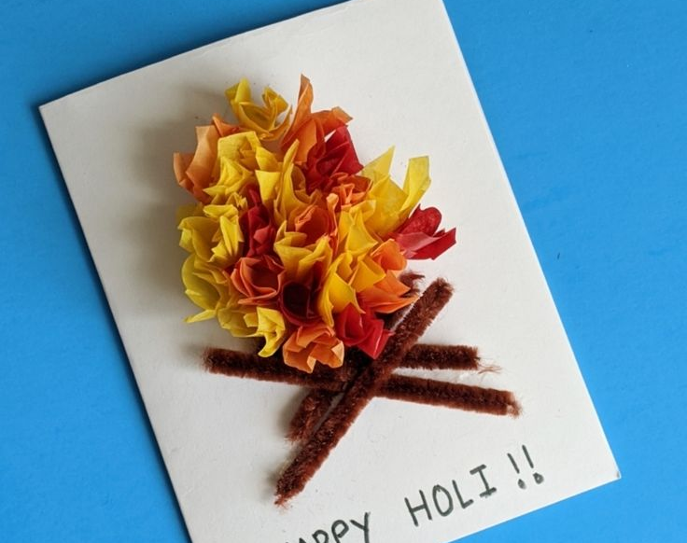
Holi Card
So we are now going to make a Holi Bonfire Card.
You will need your bag with pre-folded card, red, orange & yellow tissue paper and glue.
You may also need one of the pencils from the bag dated 17th March if you don’t have a pencil with a rubber on the end. (Don’t forget to put it back in the bag afterwards!)
Now follow my instructions.

Slide 9
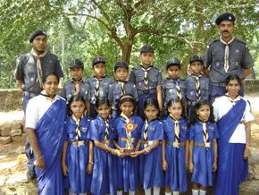
Scouting in India
Scouting started in India in 1909 and for many years several Scout and Guide Associations existed. By 1951 the Associations had merged to form The Bharat Scouts and Guides. There are three Sections in the Association:
Cub Scouts aged 6 - 10 years
Scouts aged 10 - 18 years
Rovers aged 18 - 25 years.
India (Cubs) I promise to do my best To do my duty to God and my country To keep the law of the Cub Pack And, to do a Good Turn everyday.

Slide 10
Antakshari – A Cub Scout game from India
Antakshari is an entertaining Indian desi game is often played by grown-ups and children alike. It originated in Indian and is now played worldwide with alterations. Variations can be made to the original idea to suit the occasion such as family gathering, weddings, parties, etc. To play this game, two teams are made. One team sings a song, typically a Bollywood song. The other team has to sing a song beginning with the last consonant of the song sung by the first team. Both the teams keep taking turns until one can’t think of a song and thus loses.
We are going to do this with animal names, countries etc in breakout rooms where the teams can be split into 2 easily.
The first team is given the name of an animal, country, and then has to come up with another one beginning with the last letter of the one given, after which play passes to the second team and so on.
e.g. goat – tiger – rhinoceros – squirrel etc.

