Slide 1
The Astronomer Badge

Slide 2
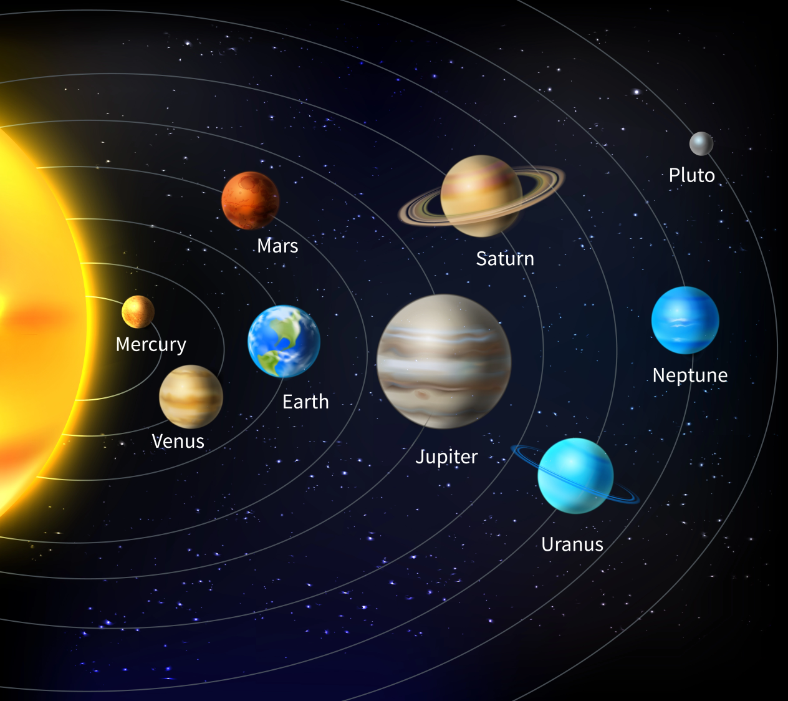
1. Make a model or draw a simple diagram of the solar system …
There are eight planets in our solar system:
Mercury
Venus
Earth
Mars
Jupiter
Saturn
Uranus
Neptune
(Pluto has been downgraded to a Dwarf Planet)

Slide 3
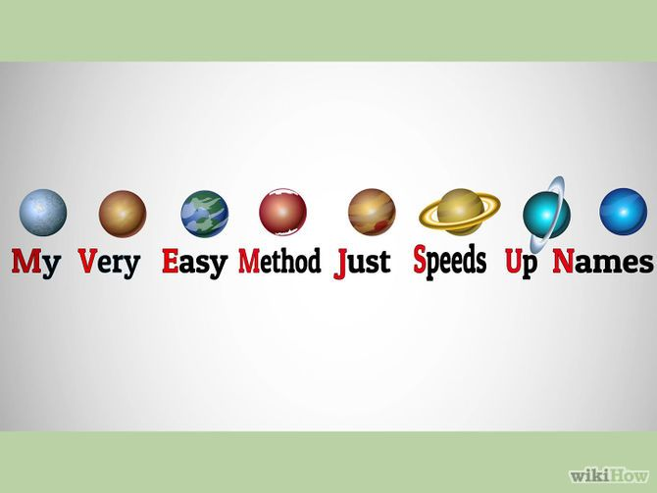
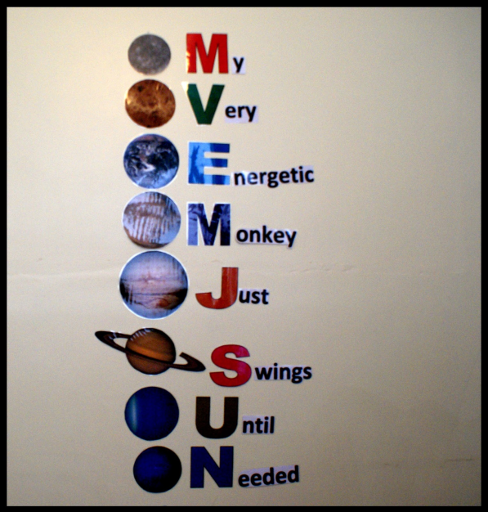
You can use something called a mnemonic to remember what order they are from the Sun.

Slide 4
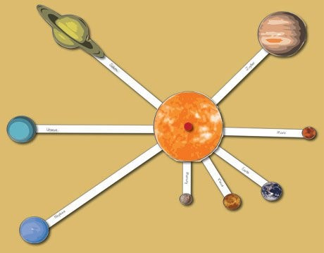
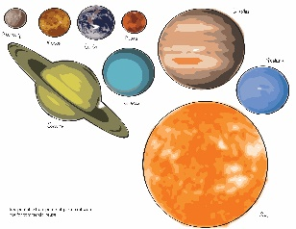
Activity …
Hopefully you should have the
following to hand:
the Solar System printouts (sent by email yesterday)
a plain piece of A4 paper (or larger)
a pair of sharp scissors
some clear sticky tape, a glue stick or similar

Slide 5
Carefully cut out the Sun and the eight planets.
Carefully cut out the eight named arms.
Stick each of the planets to its correct arm. Secure the other end of the arm to the middle of the paper as per the Finished Image diagram (or see 5 below).
Glue the Sun in the middle of your page.
If you print the images on cardstock, you could make the planets orbit the sun by just gluing them onto the ends of the arms and using a split pin in the middle to enable rotation.
Well done! You have
completed the first part
of your Astronomer
Badge!

Slide 6
2. Explain the difference between a planet and a star…
There are five main differences between planets and stars:
Planets always orbit around a star - never the other way around.
Planets are made of rock, ice, gas or water. Stars are made of plasma.
Stars emit their own light. Planets don’t.
Planets are always colder than the stars in their system.
Inside a star, nuclear fusion is constantly happening. This doesn’t happen on a planet.

Slide 7
A planet is usually defined as an object (which might be solid, liquid, gas, or a combination of all three) which is too small to produce nuclear fusion (which is the process by which the sun burns) and which orbits a star. The Earth is an example of a planet and orbits the sun, which is a star.
A star is usually defined as a body of gas which is large enough and dense enough that the heat and crushing pressure at its centre produces nuclear fusion. This is a fancy way of saying that it glows or burns, like our sun. Some stars are known to have planets orbiting around them (our sun is one example!), but not all stars have planets.

Slide 8
Kahoot! Quiz …
We willnow test your knowledge by completing this Stars vs Planets Kahoot! quiz.
https://kahoot.it/challenge/03749339?challenge-id=d44bf146-3221-4dd9-b45b-354832471056_1612124273795

Slide 9
3. Learn how to observe the Sun safely. Find out and explain how the earth moves around the Sun …
You can easily and safely observe the Sun by projecting it through a tiny hole onto a white sheet of paper. This simple device is called a “pinhole camera”. You will need two sheets of white A4 paper and a pin.
1. With the pin, punch a hole in the centre of one of your pieces of paper.
2. Go outside, hold the paper up and aim the hole at the Sun. (Don’t look at the Sun either through the hole or in any other way!)
3. Now, find the image of the Sun that comes through the hole.
4. Move your other piece of paper back and forth until the image rests on the paper and is in focus (i.e. has a nice, crisp edge).

Slide 10
What you are seeing is not just a dot of light coming through the hole, but an actual image of the Sun.
Experiment by making your hole larger or smaller.
What happens to the image?
What happens when you punch two holes in the piece of paper?
Try bending your paper so the images from the two holes lie on top of each other.
What do you think would happen if you punched a thousand holes in your paper, and you could bend your paper so all the images lined up on top of each other? In fact, optical telescopes can be thought of as a collection of millions of “pinhole” images all focused together in one place!
You can make your pinhole camera fancier by adding devices to hold up your piece of paper, or a screen to project your Sun image onto, or you can even make your pinhole camera a “real” camera by adding film.

Slide 11
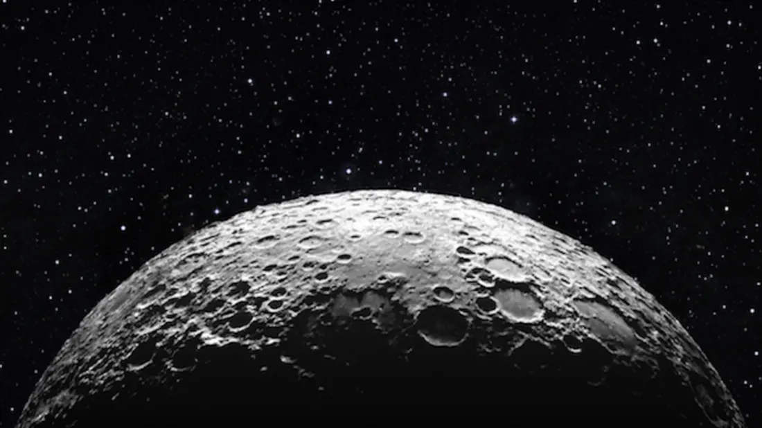
4. Observe the Moon, using binoculars or a telescope if you can, and describe some of its features ...
Without optical aid the illuminated face of the Moon appears as a patchwork of dark and light areas. If you view the Moon near full when it is close to the horizon, veiled by thin cloud or even seen through sunglasses, you can pick out a surprising amount of detail.

Slide 12
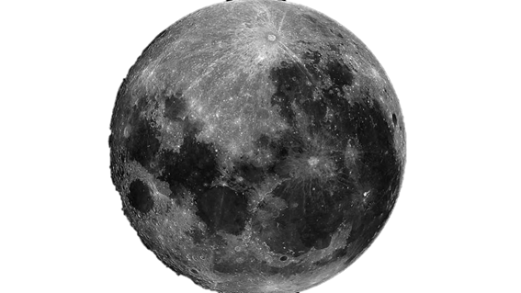
One third of the Moon’s nearside is covered with seas (Latin ‘maria’) which appear as dark patches to the naked eye. The brighter areas which surround them are mountainous, cratered regions (called continents, or ‘terra’) and the bright ray systems surrounding some young impact craters. Of course, the Moon’s seas are such in name only; early observers may once have imagined them to be tracts of water, but astronomers have known for centuries that they are decidedly solid plains. The maria are vast sheets of lava that flooded large asteroidal impact craters several billion years ago.

Slide 13
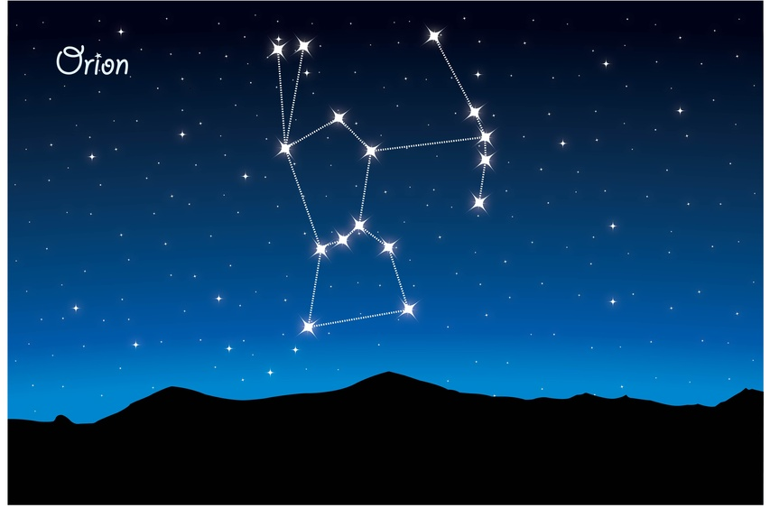
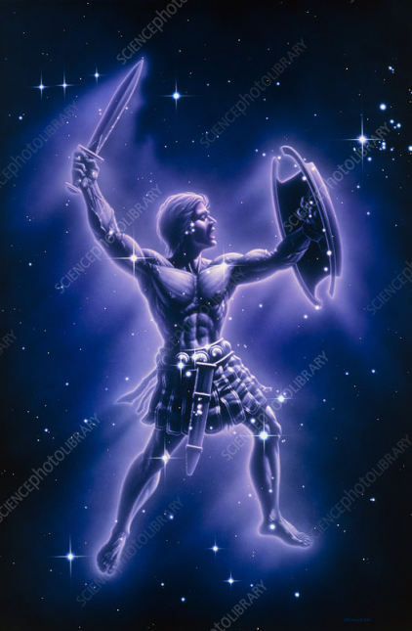
5. Identify three constellations …
On a clear, starlit night, can you identify the following constellations?
The three stars across the middle are referred to as Orion’s Belt.
Orion

Slide 14
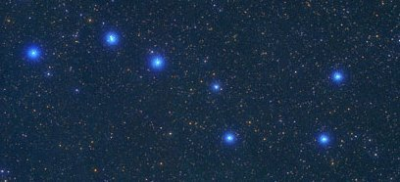
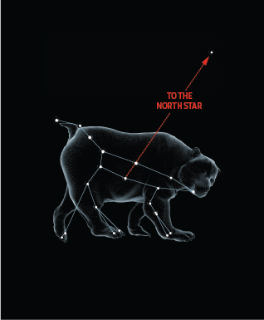
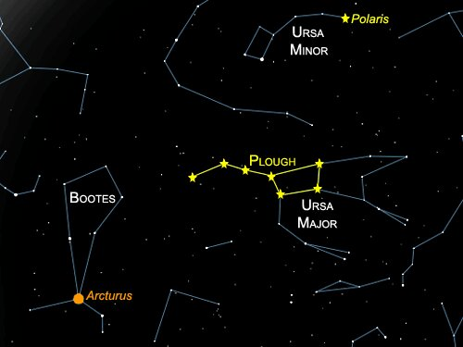
The Plough
The Plough is also known as The Big Dipper, Ursa Major or the Great Bear. This constellation can help you locate The North Star.

Slide 15
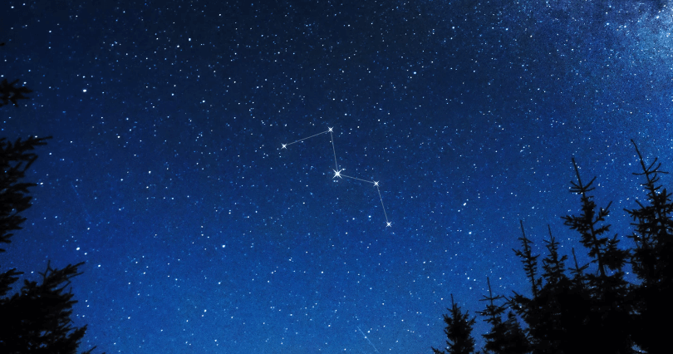
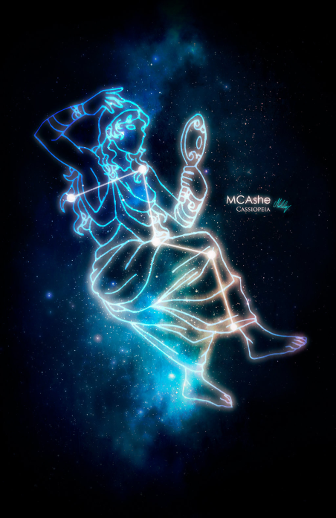
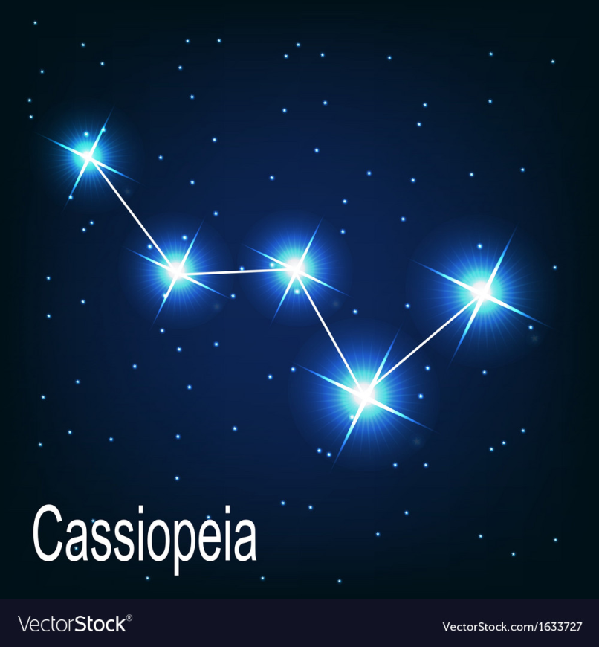
Cassiopeia
In the shape of a W, can you spot this
distinctive constellation in the night sky? It might appear to be upside down.

Slide 16
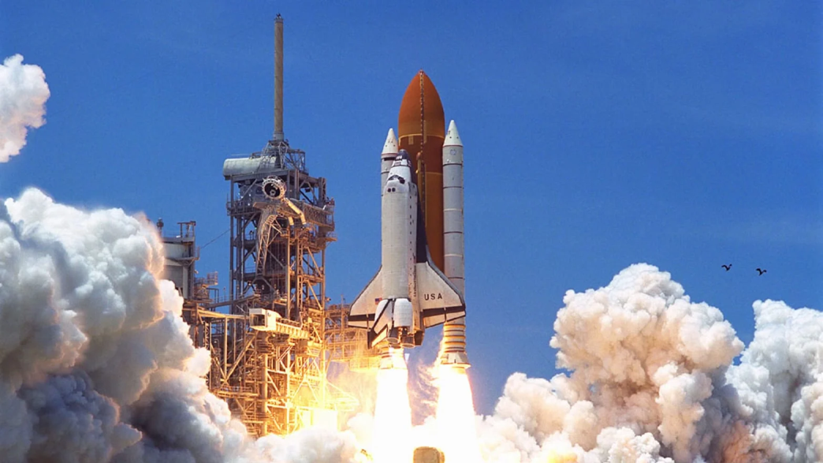
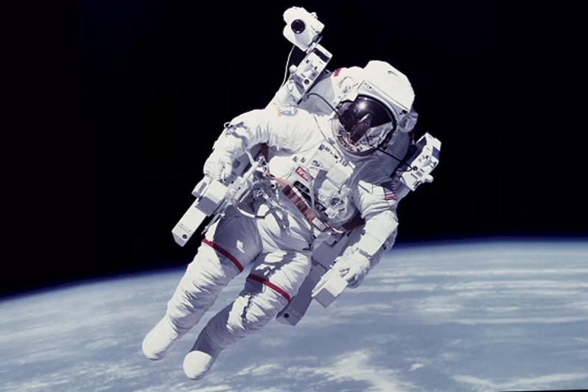
6. Find out about two space-related subjects and present some information about them.
It’s over to you …
Once you have completed this part of the badge, let Akela know what you have discovered.
Maybe one day you will have the chance to visit the moon!

